Slide 1
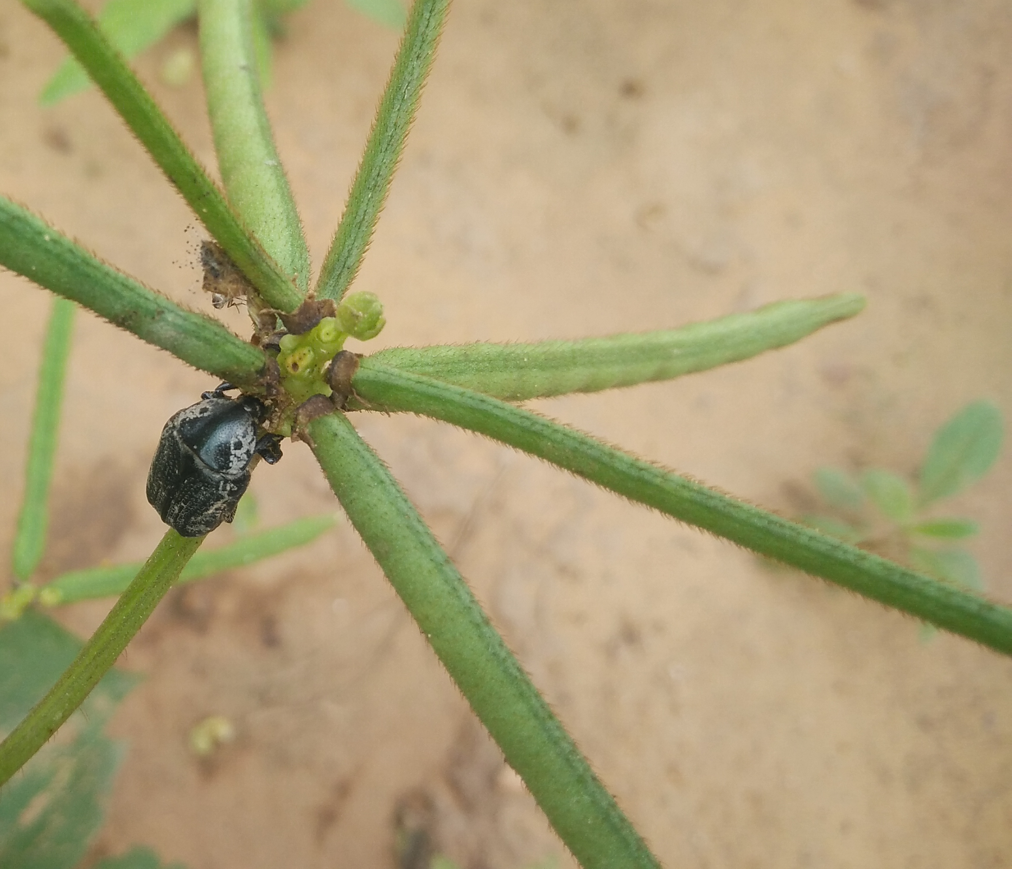
Insect Pest Management in Legume crops
Nisha Patel Central Arid Zone Research Institute, Jodhpur
Presented during Group meeting organized by ICAR-ATARI, Jodhpur for 26-27 July 2018-19

Slide 2
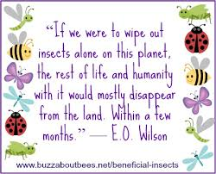
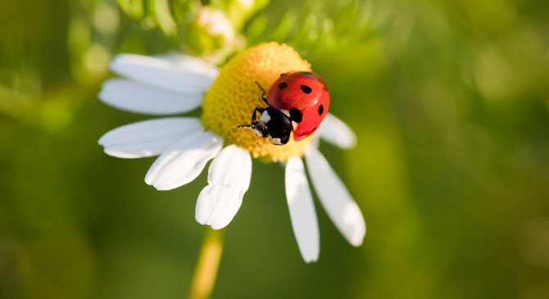
Insects : some quotes
Jonas Salk was an American medical researcher and virologist. discovered and developed polio vaccine
E. O. Wilson, is an American biologist, researcher

Slide 3
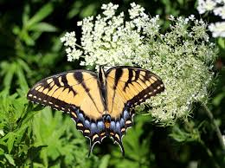
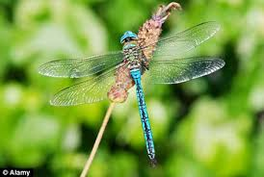
Insects : some interesting facts
Insects are the most common, and abundant of all terrestrial animals.
In terms of diversity and numbers more than all other animals combined .There are currently roughly 1,032,000 described species of animals on the planet earth. The total number may be much higher, as much as 10-30 million in fact. Of those described species, insects comprise 751,000 species or 72.8% of all the animals.
Of all the insects in the world, only 1% of insects are pests (Triplehorn & Johnson 2005) but they are responsible for the loss of 13% of crops and 9% of forest production (Pimental et al. 2000)

Slide 4
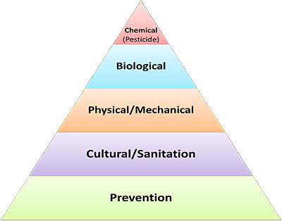
Integrated pest management
Reduce pest populations to levels below those causing economic impact, using multiple, compatible techniques
Yield enhanced
Minimizes adverse effect on environment

Slide 5
MAJOR PESTS OF LEGUME CROPS
GROUND PESTS termites, whitegrubs , cutworms
SUCKING PESTS : Aphids, whiteflies , jassids, bugs
DEFOLIATORS : grasshoppers, beetles, caterpillars
POD BORERS

Slide 6
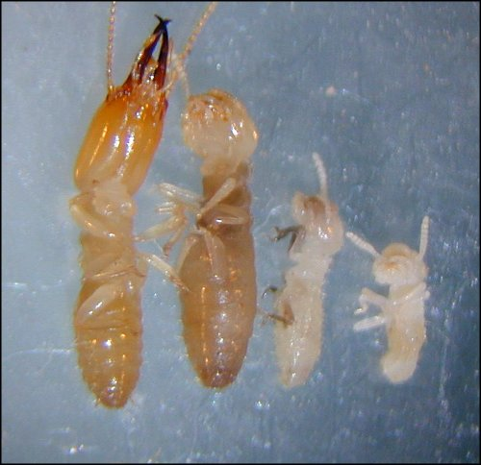
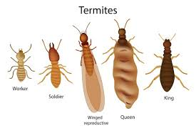
TERMITES
Termites are among the most successful groups of insects on Earth, More than 2000 species, only 285 species in India
Live in colonies whose size range is from a few hundred individuals to enormous societies with several million individuals.
18-20 ft depth
Termite queens lay upto 1000 eggs per day have the longest lifespan of any insect in the world, with some queens reportedly living up to 30 to 50 years.

Slide 7
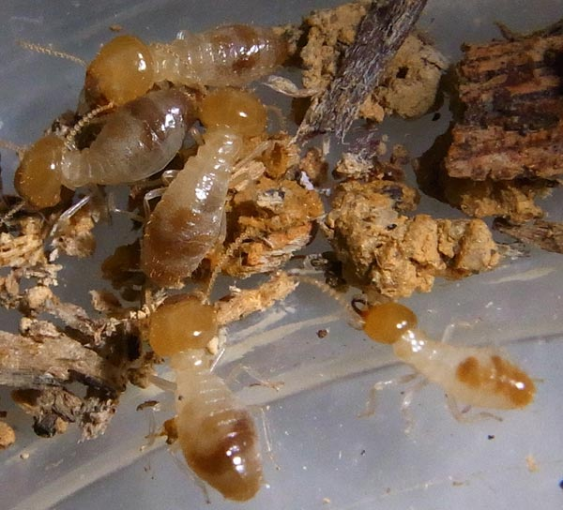
TERMITES
These insect feed and make galleries inside the roots of most of the crops of arid regions. The plant dries up and dies due to damage by termites
Termites Odontotermes obesus (Termitidae: Isoptera)
Control
Seed treatment with 4-6 ml chlorpyrifos or 10 ml imidacloprid 600fs per kg seed
chlorpyrifos dust
Using properly decomposed manure

Slide 8
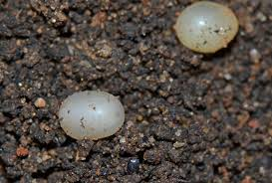
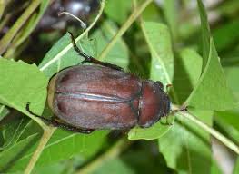
WHITEGRUBS
One of the most destructive pests of crops in sandy soils,
Larva or grub of the is a white stout and C shaped
Feed underground on the roots of the plants due to which the plant withers and dies.
Control
Quinalfos 1.5% dust@25kg/hectare or carbofuran 3% dust or 4 L
4 L Chlorpyrifos 20 EC per hectare

Slide 9
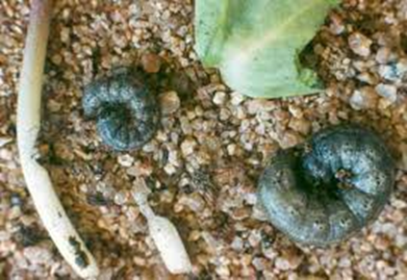
Cutworms Agrotis ipsilan (Noctuidae: Lepidoptera)
adult is brownish-gray in color; the wingspan is about 35-50 mm (1.36-1.97 inch), with typical dagger-like marks on the wings.
Eggs are preferentially deposited on low plants or dead plant material in damp areas of untilled fields.
After 3-6 days, the larvae hatch. During the first two instars, they feed on leaves; older larvae hide in cracks or under lumps of soil, where they construct small tunnels or burrows down to depths of 3-10 cm only coming out for feeding after dark.
They come out during the night and cut plant shoots at the base. In some cases entire rows of the plants are cut, making replanting necessary.

Slide 10
CUTWORM
Lifecycle Eggs are preferentially deposited on low plants or dead plant material in damp areas of untilled fields.
After 3-6 days, the larvae hatch. During the first two instars, they feed on leaves; older larvae hide in cracks or under lumps of soil, where they construct small tunnels or burrows down to depths of 3-10 cm only coming out for feeding after dark.
Six (occasionally seven) instars develop during a 25-35 day period; the pupal stage lasts another 12-15 days.
Several generations per year are possible

Slide 11
DEFOLIATORS
Catterpillars
Grasshoppers
Grey weevils

Slide 12
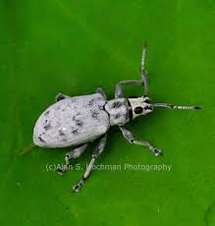
Grey weevil
Adult weevils are 8mm long, greyish-brown in colour
and have a have a prominent snout.
Adults feed on leaves of most kharif crops
Larva feeds on the secondary roots
Spray
Quinalphos 25 EC 1 l/ha
Carbaryl 50 WP 1 kg/ha

Slide 13
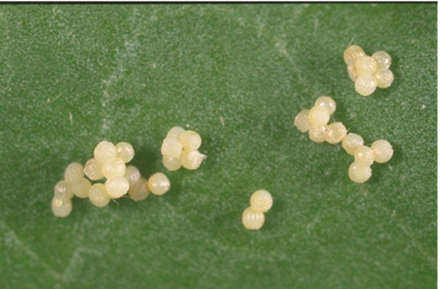
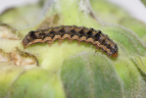
Heliothis armigera
polyphageous, and is a pest of about 200 species
Considered one of the most serious insect pests worldwide,
causing huge losses due to its high reproductive potential and polyphagy.
Economic damage is greatest in cotton and vegetables. In grain legumes sometimes up to 80% of the crop can be destroyed.

Slide 14
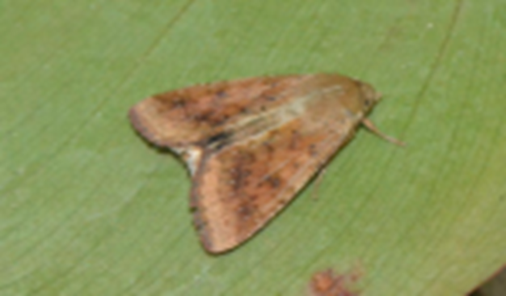
Heliothis armigera
Each female of H. armigera can lay several hundred eggs, distributed on all parts of the plants, flowers and fruit included. At optimal temperature, the larvae can hatch after less than three days. They then pass through four instars over a three to four week period.
The caterpillars are voracious feeder,
If disturbed, they let themselves drop from the plant and roll up on the ground.
They pupate inside a silken cocoon several centimetres deep in the soil.
Ploughing of the field after harvesting kills and exposes the pupae in soil.

Slide 15
Management
ETL: 5-6 eggs or 2-3 small larvae / plant ,
Azadirachtin 0.03 % WSP 2500-5000 g/ha
Bacillus thuringiensis 5%WP 1000-1250 g/ha
Dimethoate 30% EC 1237 ml/ha
Emamectin benzoate 5% SG 220 g/ha
Indoxacarb 15.8% SC 333 ml/ha
Spinosad 45%SC 125-162 ml/ha
NSKE 5% twice followed by triazophos 0.05%
Neem oil 2%
Ha NPV spray NPV @ 250 LE / ha + 0.1 % teepol
Bird perches @ 50 / ha, Set up light trap
Pheromone traps @ 12 / ha

Slide 16
GRASSHOPPERS
sporadic pests.
some years large populations may build up and then migrate into nearby crops , often defoliating everything
adult female grasshoppers deposit their eggs in soil in undisturbed areas such as bunds pasture areas
Eggs are laid in the upper 2 inches of soil in elongated pods that contain 20 to more than 100 eggs.
When conditions are conducive eggs hatch and the young nymphs begin to feed on nearby plants.
Nymphs move to new locations when food supplies disappear. Most species molt five to six times before becoming adults and usually have only one generation a year.
Adult grasshoppers can live two to three months; they die out when food becomes scarce or when the weather becomes too cold.
Many predators eat grasshoppers, including birds, blister beetles (which feed on eggs), and robber flies. Fungal and bacterial diseases as well as parasites also kill grasshoppers.

Slide 17
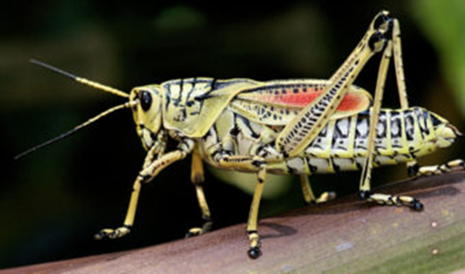
Grasshoppers
Birds and reptiles are excellent predators
keep an attractive green border of tall grass on borders.
If a grasshopper trap crop is being grown around the border, these can be baited or sprayed with carbaryl or other products to kill grasshoppers.
These insecticides have only a few days of residual activity against grasshoppers, and because baits lose their effectiveness after rain or irrigation, they will need to be reapplied if migrations continue.
Small grasshopper nymphs are easier to control with insecticides than larger ones, and adults are very difficult to control.
Carbaryl and other insecticides such as cyfluthrin or other pyrethroids commonly used as sprays for grasshopper control are very toxic to bees, natural enemies of grasshoppers

Slide 18
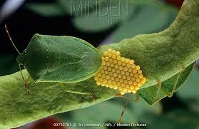
Sucking Pests
Aphids
Jassids
Bugs
whiteflies

Slide 19
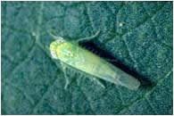
JASSIDS
Leafhopper (Amrasca biguttula biguttula Ishida)
Both adults and nymphs suck the sap from leaves.
The eggs are inserted into the midrib or veins.
On hatching the nymphs move along the veins and nymphs suck
the leaf sap.
On the older leaves, the damage is seen as yellowish-green mosaic patches followed by brown necrosis and curling along the leaf margin.

Slide 20
JASSIDS CONTROL
Soil application of neem cake 250 kg/ha followed
by sprays of NSPE 4% or neem soap 1% at 10 days
interval.
Spray of systemic insecticides like Dimethoate
30 EC @ 2ml/l or Imidacloprid 200 SL @ 0.3ml/l or
Acephate 75 SP (1 g/l) at pre-flowering stage.

Slide 21
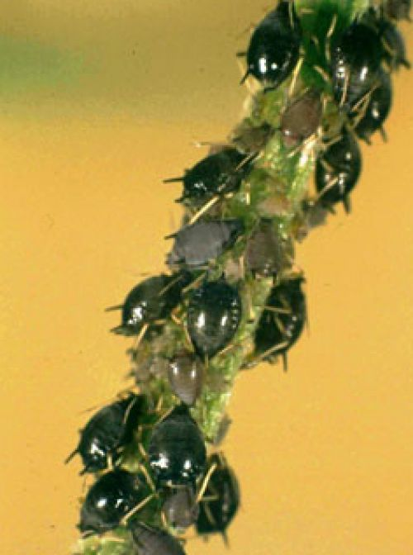
Aphids: Aphis craccivora
Leaves, inflorescence stalk and young pods covered with dark coloured aphids
Honey dew secretion with black ant movements
Identification of the pest
Nymphs and Adult – dark coloured with cornicles in the abdomen
Management
Spray any one of the following insecticides (Spray fluid 500 l/ha)
Emamectin benzoate 5% SG 220 g/ha
Indoxacarb 15.8%SC 333 ml/ha
NSKE 5% twice followed by triazophos 0.05%
Neem oil 2%

Slide 22
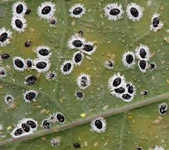
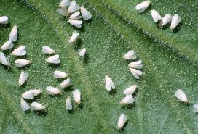
Sucking pests whiteflies
Adult females lay eggs on the lower surface of apical leaves.
Eggs hatch after a week.
The crawlers dig their mouth parts into the leaf tissue for sucking the sap and remain static as “scales” throughout the remaining part of their larval and pupal period.
Serious damage is caused by the excretion of honeydew secreted by the by whitefly,
Under moist conditions, sooty molds can develop on the honeydew, reducing photosynthesis and hindering respiration of plants.
The damage by whitefly also leads to yellowing of leaves and stunted growth, in severe cases leading to shedding of leaves

Slide 23
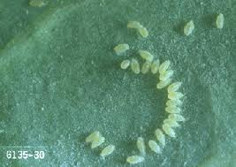
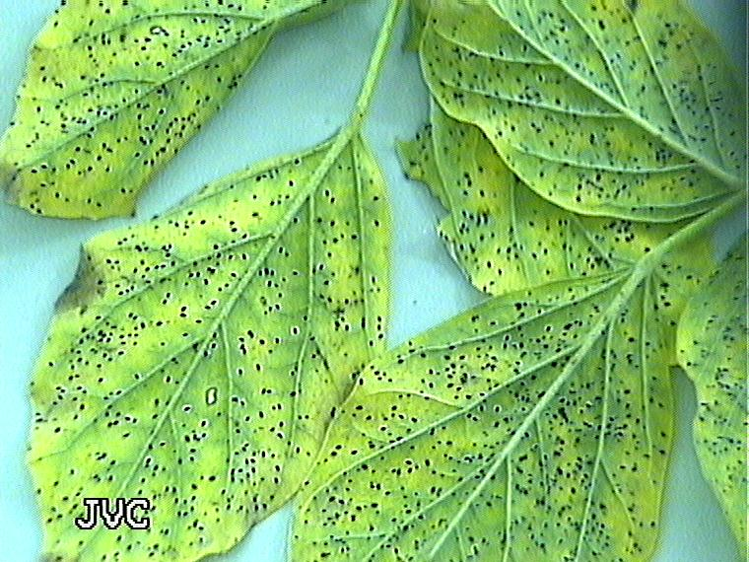
WHITEFLIES
Sucks sap from lower surface of leaves due to which leaves, curl and dry up secretes sticky honeydew spreads yellow mosaic virus
Spray dimethoate 0.03 % or methyl demeton 0.025% , imidacloprid
Use neem seed kernel extract (5%)

Slide 24
Nezara viridula
Dimethoate 30% EC 500ml/ha
Methyl demeton 25%EC 500ml/ha
Imidacloprid 17.8 SL 100-125 ml/ha
Thiamethoxam 25% WG 100 g/ha

Slide 25
Pests as Pod feeders
pod borer Helicoverpa armigera (Noctuidae: Lepidoptera)
Spotted pod borer Maruca vitata (Pyralidae: Lepidoptera)
Blue butterfly Lampides boeticus (Noctuidae: Lepidoptera)
Plume moth Exelastis atomosa (Noctuidae: Lepidoptera)
Spiny pod borer Etiella zinckenella (Noctuidae: Lepidoptera
Pod Bugs Riptortus pedestris Clavigralla gibbosa (Coreidae:Hemiptera)
Stink Bugs Nazara viridula (Pentatomidae:Hemiptera)
pod borer Adisura atkinsoni (Noctuidae: Lepidoptera)

Slide 26
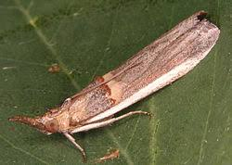
Etiella zinknella
Larvae bore into pods and feed within the pods until they are ready to pupate.
When larvae leave the pods they sometimes produce webbing around the pods.
The exit holes made by larvae increase the aflatoxin risk in peanuts.
Etiella damage is not obvious until harvest.
Hand picking
Destruction of infested pods along larva
Spray BT – 0.1% @ 50% flowering stage
Field release of Trichogramma chilonis @5 cc/ha
Use light trap at 1 /ha
BIRD PERCHES

Slide 27
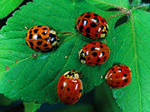
Ladybird beetles
Larvae and adults eat aphids, thrips, mealybugs, various small larvae, beetle grubs, scales, spider mites, whiteflies, other soft-bodied pests, and insect eggs.
Attracted to pollen and nectar plants
One generation per year.
Adults over-winter in garden litter.

Slide 28
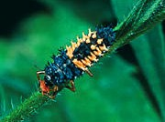
Predators lady bird beetles
Eggs are yellow-orange and spindle-shaped.
larvae are 1/4"to l/2" long, covered with tiny spines, gray or black with blue and orange markings, and resemble tiny alligators.
Adults of the common lady beetle are l/4" long, reddish-orange beetles with spots and generally feed on aphids.

Slide 29
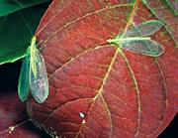
Green Lacewings
Adults 1/2" to 3/4" long, slender body, delicate long green wings.
They lay oval eggs on slender stalks which hatch in 6-14 days.
Larvae are called aphid lions and are 3/8" long, yellowish-gray with brown marks and tufts of hair.
Larvae eat aphids, mealybugs, mites, scale insects,thrips , whiteflies, and eggs of caterpillars, mites, thrips. Eat up to 60 aphids per hour.

Slide 30
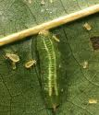
Predators HOVER FLY/SYRPHID FLY
Hover flies or Flower flies are important pollinators
Look like bees/flies. They hover on flowers and feed on nectar. are l/2" long, black with yellow bands
Larvae feed mainly on aphids, but also leafhoppers, scale, mealybugs, thrips. Larvae are legless, green or brown
As many as 400 aphids may be consumed by one larva during its development period.

Slide 31
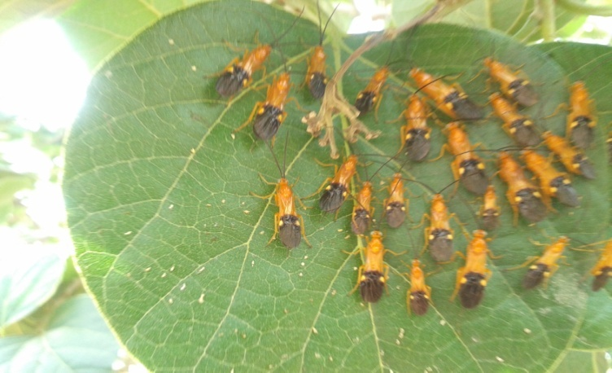
Parasitic wasps
Lay eggs on the eggs or larvae of pest insects especially catterpillars
The smallest most popular parasitic wasp -Trichogramma, a minute creature that lays up to 300 eggs in moth or butterfly eggs.
Braconid wasps , chalcid, wasps, ichneumon wasp (egg parasite of caterpillars, sawfly and beetle larvae, and other insects. Female may feed on body fluids of host.)

Slide 32
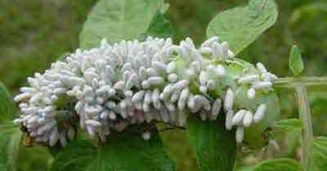
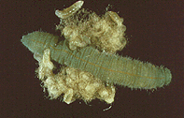
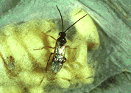
Braconid wasps
These wasps parasitize a wide range of insects but chiefly aphids and the larvae of moths, beetles, and flies.
The adults are relatively small
many of them pupate in silken cocoons on the outside of the body of the insect host.

Slide 33
Enhancing biodiversity
The larval or young stages of many beneficial insects feed on other insects
adults of most of the predators and parasitoids of pest insects require nectar and pollen at certain stages of their life for growth and reproduction.
A diversified ecosystem provides microhabitats, food sources (prey, nectar, pollen), alternative hosts and shelter for natural enemies.
The plant species chosen should not attract insect pest.
the flowering should be in succession so that food is available for beneficial round the year.

Slide 34
Plants that attract beneficial insects
Plants that have flowers with a good amount of nectar/ pollen, like Umbelliferae, Compositae, and Brassicaceae are especially attractive for insects.
Flowers which are attractive in colours , small shallow flowers, extrafloral nectaries promote or encourage beneficial insects on the farm.
Senna plant in the fields also supported parasitoid population as they have extrafloral nectaries which provided food to beneficial insect during off season.

Slide 35
Shrubs /trees
many plants like ber and henna
provide pollen and nectar to variety of pollinators, predators and parasitoids besides providing shelter for insects like lacewing, many lacewing eggs were seen on henna and ber plants.
Predatory wasps in good numbers on ber flowers.
Few Calotropis shrubs on the farm encourage beneficial insects like coccinellids and syrphids
Acacia senegal trees was also a good source of pollen and nectar and it attracts and support many types of pollinators and parasites

Slide 36
Soil management and plant health
Crucial role in prevention of insect damage
Healthier soils produce plants that are less damaged by pests.
Healthier soils also harbor more diverse and active populations of the soil organisms that compete with, antagonize and ultimately reduce soil-borne pests.
Use of FYM and neem seed cake enrich soil and favour multiplication beneficial organisms besides improving the physical properties of soil.

Slide 37
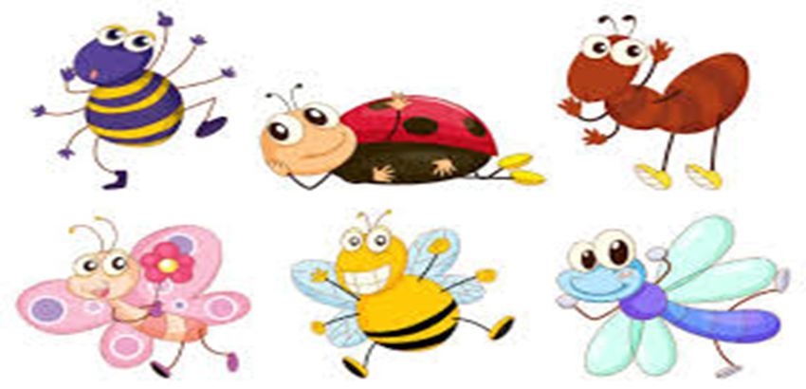
When we kill off the natural enemies of a pest we inherit their work” Carl Huffaker
Thanks

